Slide 1
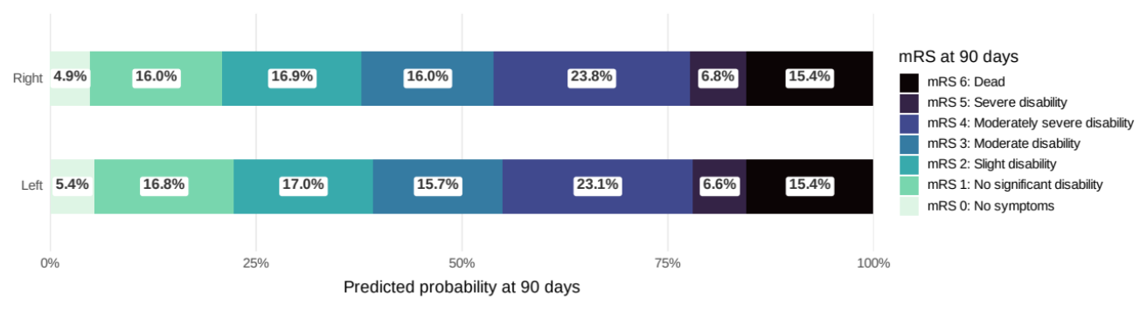
Question: In patients enrolled in ATACH-2 and ERICH with supratentorial ICH, is there an association between hemispheric laterality and the likelihood of neurosurgical intervention?
Conclusion: Right hemispheric ICH is associated with a higher likelihood of neurosurgical intervention compared to left hemispheric ICH, though 90-day functional outcomes remain similar between groups.
Patient Population and Study Design
Findings
Left Hemisphere
Right Hemisphere
aOR 1.65
95% CrI 1.28–2.14
Neurosurgical Intervention
86 patients (5%)
144 patients (8%)
Post-hoc analysis of 2 prospective studies
3477 adults with supratentorial ICH enrolled in ATACH-2 and ERICH
Bayesian hierarchal regression adjusted for age, admission Glasgow Coma Scale, ICH location, ICH volume, and intraventricular hemorrhage
External Ventricular Drain
aOR 1.22
95% CrI 1.04–1.44
236 patients (14%)
272 patients (16%)

